Slide 1

CAPSTONE PROJECT
ABG MOTORS IN INDIA
By : Akshat Chauhan

Slide 2
PROBLEM STATEMENT :
This Project is based on a car company ‘ABG Motors’, a fictional Japan-based car motors company .
ABG Motors believes that the Indian market is very similar to Japanese, in which the company currently operates.
Before entering the new market, the company wants to be sure that the whole process will be profitable for them.
Hence, we are given the task to check for the following conditions that must be fulfilled in the Indian market for the company to enter:
Sale of a minimum of 10,000 Cars over the sample data in one year .

Slide 3
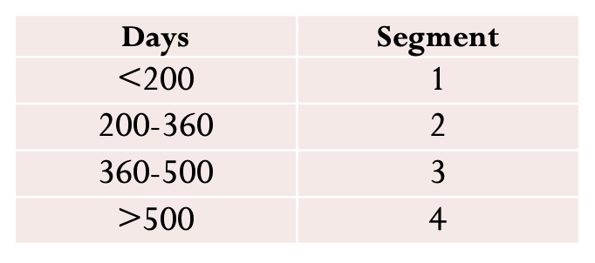
T1: JUSTIFICATION DURING MODEL DEVELOPMENT
Gender was classified into binary data as male (1) and female(0). The annual income was converted into INR for matching the situation of Indian currency
From the Chinese customer data it is clear that purchase decision depends on 4 factors. Customer age, Gender, Car Age, and annual income. The following changes were made on the raw data

Slide 4
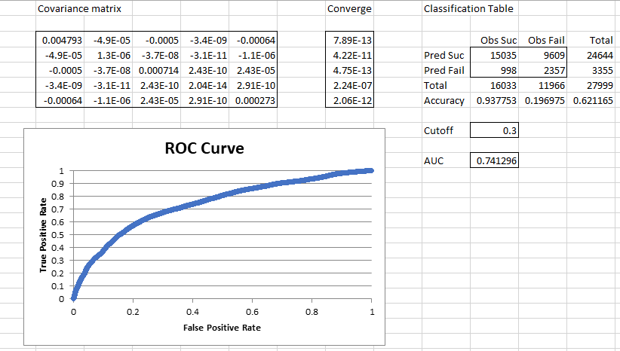
Then after dataset is converted into training and test set with 70:30 Rule and Logistic Regression Modelling Is Performed On both of them.
And then ROC Curve, Beta Values and Conversion Matrix (Including Accuracy, Sensitivity, Precision etc.)Is Computed from train and test data through K-means Clustering

Slide 5
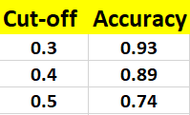

Slide 6
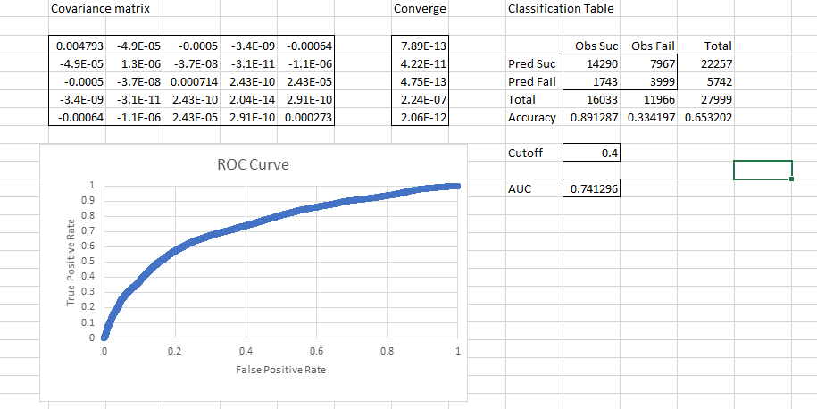

Slide 7
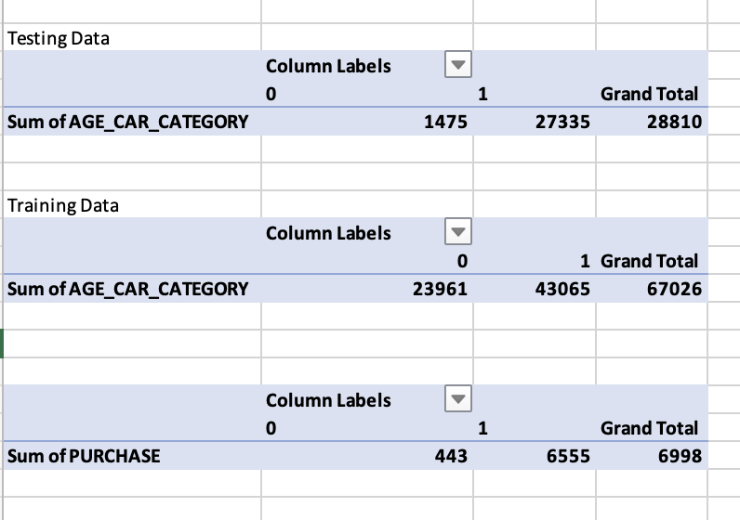
T1: PIVOT Tables

Slide 8
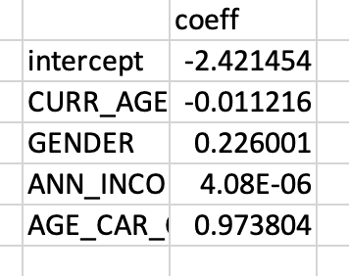
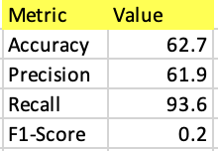
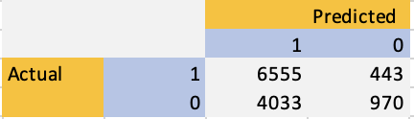
CLASSIFICATION MODEL BASED ON JApanese DATASET
The logistic regression was made on the formatted data by considering the factors like age, gender, income, car life and purchase.
The coefficients B0 to B4 and ROC Curve of training Data are computed as follows:

Slide 9
T1: COUNT OF POTENTIAL CUSTOMERS IN INDIA BASED ON MODEL
The data set is formatted such that gender is converted into a binomial model and the phone age is calculated by considering the purchase date as 1st July 2019.
The phone life is converted into 4 categories as follow:
The probability is computed based on coefficients (B0 to B4) obtained from the Japanese Dataset.

Slide 10
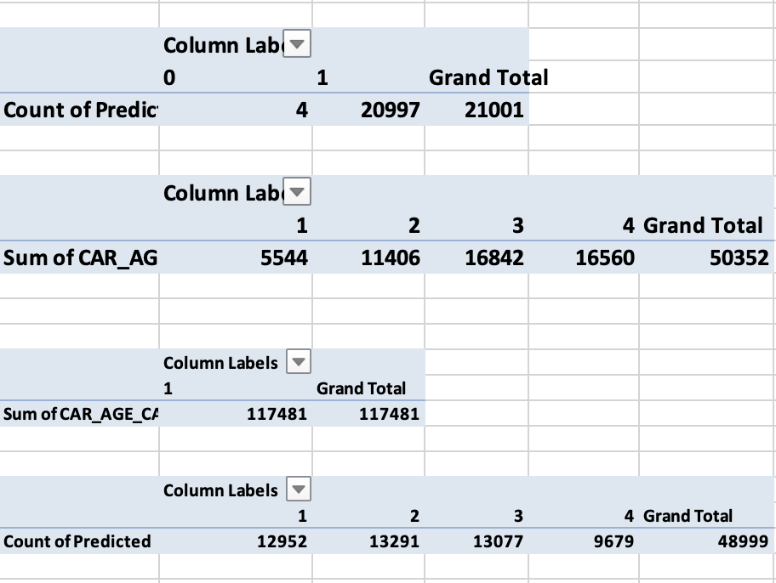
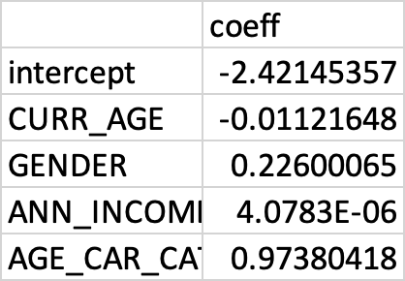

Slide 11
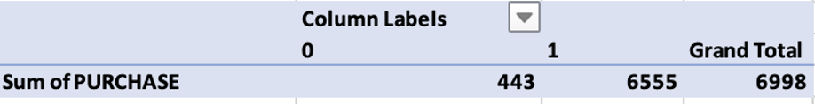

JUSTIFICATION FOR FINAL RESULTS
Japan
India

Slide 12
JUSTIFICATION FOR FINAL RESULTS
From the Table Below we can conclude that Customer Age Segment 3 ,count of purchase is 13077 which is way over our required result that is minimum 10000 cars, in INDIA as compared to other segments so ABG Motors company must target Middle aged customers and so, yes they can enter in INDIAN market as there is no loss for XYZ Mobile Company.

